Slide 1
Simple Linear Regression

Slide 2
Linear Regression Equation
y – dependent variable
x – independent variable
b₀ – constant
b₁ – coefficient

Slide 3
aaa

Slide 4
Constant b0 in the Linear Regression Equation
Linear Equation: y = b₀ + b1 * x
when the x is 0 then the second term is zero, hence y = b₀ ……… (b₀ is the constant)
Suppose: Salary = b₀ + b1 * Experience
when experience is 0 then salary will be = b₀ (say b₀ = 30K then inexperienced candidates will get salary of 30K.

Slide 5
aaa

Slide 6
Coefficient b1 will represent the change in y value when x value changes.
Suppose +1 year of experience will increase the Salary by 10K.
B1 represents the slope of the line. Greater the slope y value increases.

Slide 7
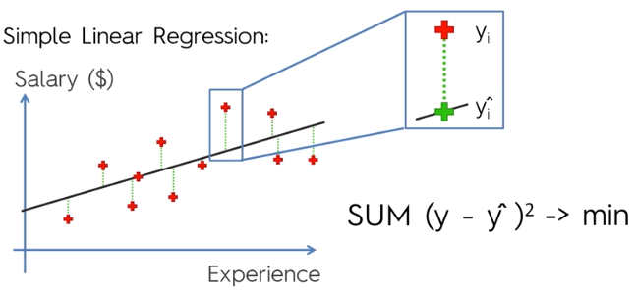
Ordinary Least Squares Method
The red points represent actual data points. The model draws a line so as to pass through them.
The model draws the line and then calculates the distance between each data point & the line, squares it & records it in a temporary file.
At the end it selects only the Least Squares (Min Square values), adjusts & redraws the line.

Slide 8
Multiple Linear Regression

Slide 9
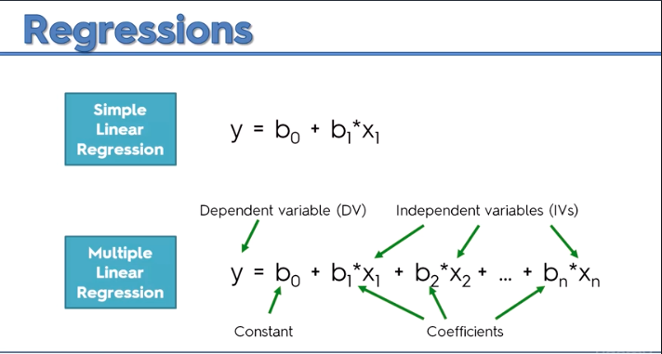

Slide 10
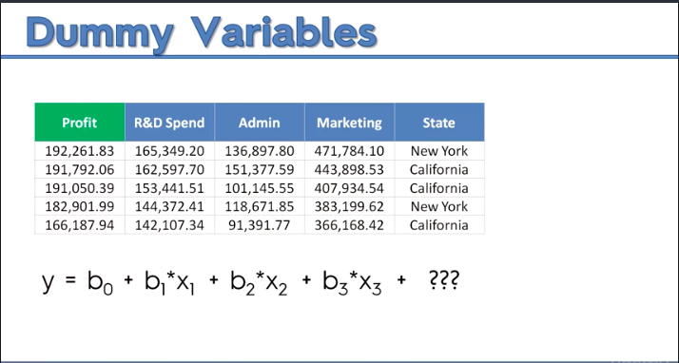

Slide 11
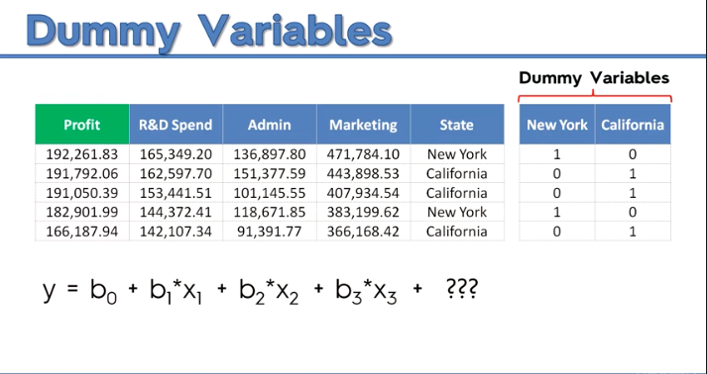

Slide 12
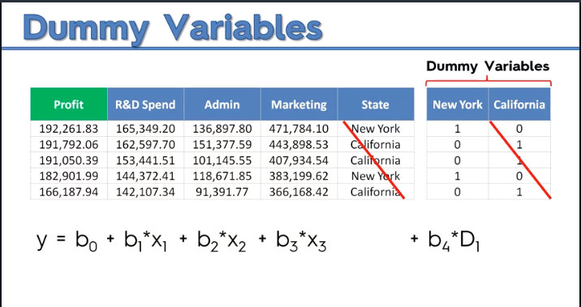

Slide 13
